Slide 1
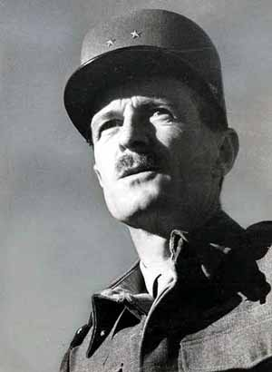
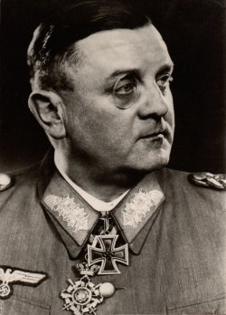





Liberation of Paris
August 19 – 25, 1944
Overview
On June 6th 1944 Operation Overlord began with the Allied D-Day landing in Normandy. By the time of the successful Allied landing on the beaches of Normandy, it was inevitable that Germany would eventually lose the war. On August 13th the German counterattack at Mortain had failed & by August 20th the Allies had closed the Falaise Gap, forcing 50,000 Germans to surrender & thus controlled most of Northern France west of the Seine & north of the Loire rivers. On August 15th, Operation Dragoon landed another 94,000 men near Toulon in Southern France. Meanwhile, on August 7th Adolf Hitler gave Dietrich von Choltitz the position of Military Governor of Paris.
Key
Free French
French Resistance
United States
Germany
Milice

Slide 2
Liberation of Paris
Forces
Free French & FFI
Philippe Leclerc
Henri Rol-Tanguy
2nd Armored Division (14,454)
FFI (20,000)
4th U.S. Infantry Division (29,180)
Total: 63,634
Germany
Dietrich von Choltitz
5,000 inside Paris
20,000 outside Paris
50 artillery & company of tanks
Milice (unknown)
Total: 25,000

Slide 3
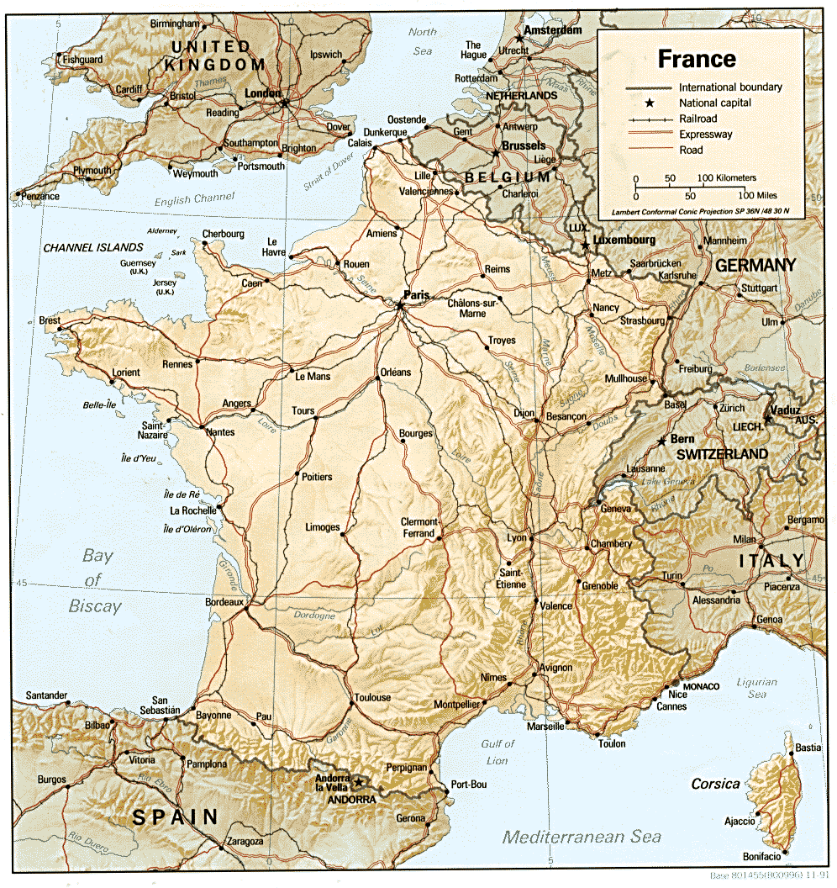
Liberation of Paris

Slide 4
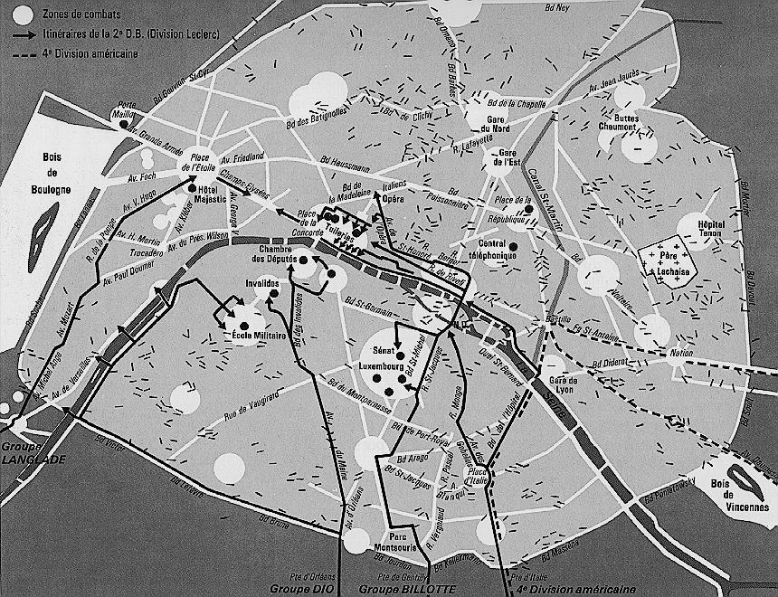

9. On August 22nd the violence escalated as Germans attempt to leave their strong points & the FFI fortified the city centre. On August 23rd at 6:30 a.m. Adolf Hitler ordered Choltitz “Paris must not fall into enemy hands except as a field of ruins.” At 9:00 a.m. Choltitz ordered the FFI stronghold of the Grand Palais burned & began using Panther tanks to attack FFI barricades. More than 500 FFI had died since the uprising started.
8. At the same time an SS patrol would arrest Alexandre Parodi & 2 other Gaullist FFI leaders, however Choltitz ordered them released because he believed they could help restore peace to the situation in the city. Parodi rushed to his apartment on the Rue Sain-Augustin where he began Operation Prise du Pouvoir were he with the help of Yvon Morandat established a substitute cabinet for Charles de Gaulle at the Hotel de Matignon.
5. The Resistance destroyed road signs, punctured tires, cut communication lines, bombed gas depots, captured vehicles, built barricades & attacked isolated pockets of German soldiers, but they feared open warfare & on August 20th Swedish Consul-General Raoul Nordling reached an agreement on a truce with Choltitz. Choltitz acknowledged certain parts of Paris as belonging to the Resistance, while Nordling agreed to recognize other parts of Paris belonged to the German garrison.
6. Choltitz also stated he was not willing to surrender to any irregular soldiers for the sake of honor. The truce was advantageous to both the Germans & the Resistance because it allowed the Germans to concentrate their efforts elsewhere & for the Resistance it delayed the destruction of Paris & it’s people & allowed them to strengthen their position.
1. On August 15th the citizens of Paris started going on strike. Railway workers, postmen, police, & undertakers began striking, a suburban ambush killed 8 Germans & the Gestapo left Paris the next day. By August 18th Paris was at standstill. The police had disappeared, anti-German demonstrations were being held, German propaganda posters were being replaced with posters encouraging liberation, & Resistance members began to appear openly. At the same time, General of the Infantry Dietrich von Choltitz was making preparation to destroy the city.
3. On August 19th the FFI sprang into action with an uprising involving about 20,000 people, however only few members were armed. Those FFI members that were armed used Lebel rifles, Molotov cocktails, pistols, shotguns, Hotchkiss machine guns, & even blunderbuss.
4. The Resistance attacked & took control of the police stations, town halls, national ministries, newspaper buildings & the Hotel de Ville. In response, Choltitz orders the Great Windmills of Pantin destroyed to starve the population.
7. When the Communist leader of the FFI, Colonel Henri “Rol” Tanguy, heard of the truce he became upset & exclaimed “Paris is worth 200,000 dead … So long as the city frees itself before a single uniformed soldier marches through its gates.” & by the end of the day 106 FFI members & an unknown number of Germans would be killed.
2. On August 16th Choltitz ordered the execution of 35 Resistance members at the Bois de Boulogne waterfall & deployed 20,000 troops under Lieutenant-Colonel Hubertus von Aulock in a thin 60 mile arc at the outskirts of Paris on August 17th. On hearing of the destruction planned for Paris, the Mayor of Paris, Pierre Taittinger, visited Choltitz to try & persuade him not to destroy Paris.
Panther Tanks

Slide 5

2nd Fr. Armored Division
FFI uprising
4th U.S. Infantry Division
11. To Ike Paris was huge headache, the liberation of which would cost a great amount of time & resources, about 4,000 tons of food per day. Ike also feared that Paris might become another Stalingrad with the many priceless cultural objects in the city destroyed.
12. However on August 21st after hearing of the FFI uprising in Paris, Philippe Leclerc of the 2nd Fr. Armored Division becoming impatient with the Allies, decides to send 10 light tanks, 10 armored cars, 10 personal carriers & 150 men under Lieutenant-Colonel de Guillebon to reconnoiter the routes to Paris, however V Corps Commander Leonard Gerow orders Leclerc to recall Guillebon
10. Meanwhile, Allied Commander Dwight D. Eisenhower considered Paris of no concern to his military goals, while Charles de Gaulle, President of the Provisional Government of the French Republic, saw Paris as the hub of French national & political administration & fearing that a Communist-led insurrection in Paris would place his political opponents in power wanted his army to liberate Paris immediately.
13. but, Ike urged by de Gaulle, assurance of a quick victory, & the desire to prevent Paris being razed by the Germans, as had happened in Warsaw, convinced Ike to allow Leclerc to move. On August 22nd at 7:15 p.m. Lt. Gen. Omar Bradley ordered Leclerc to move & on August 23rd at 6:30 a.m. the 2nd Fr. Armored Division supported by the 4th U.S. Infantry Division & 4 battalions of V Corps’ artillery began to move towards Paris.

Slide 6
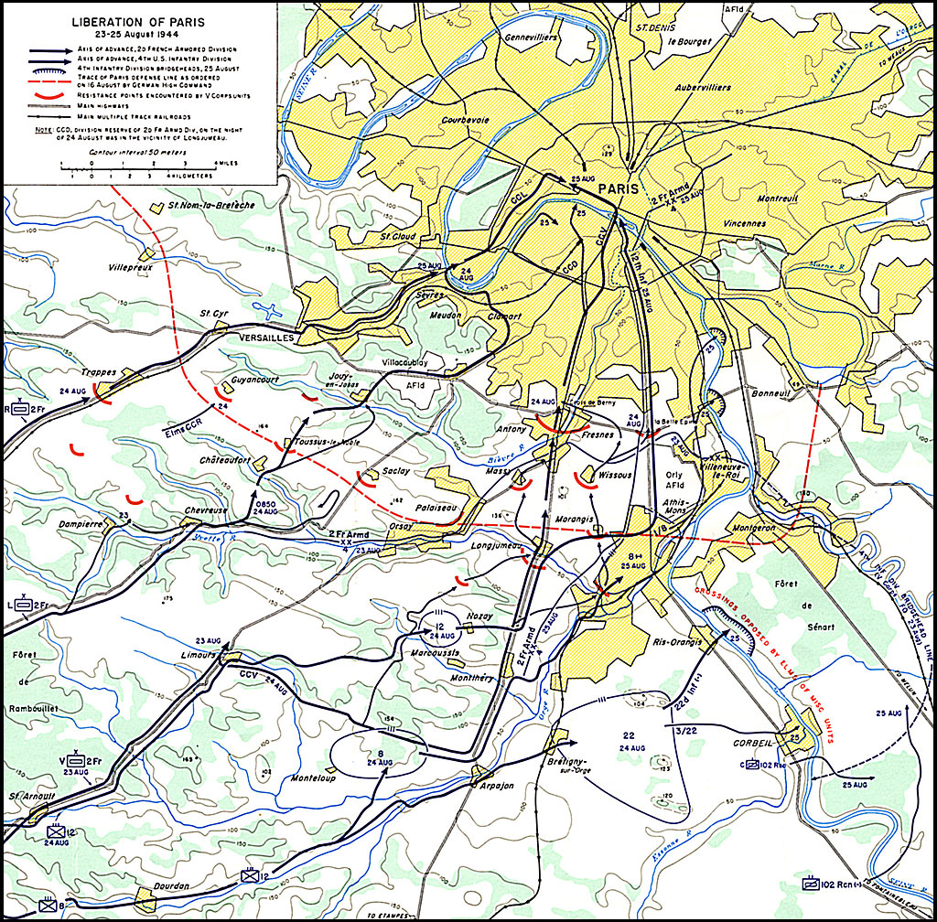
19. Meanwhile the southern force advances 13 miles by the end of the day & arrives just 5 miles the closest entrance of Porte d’Orleans, 7 miles from their final objective of the Panthénon & 8 miles from the center of Paris at the Ile de la Cité & Notre Dame. Lt. Gen. Omar Bradley became impatient & ordered the 4th U.S. Infantry Division to move without the French say: “The French dance their way to Paris. To hell with prestige. Tell the 4th to slam on in & take the liberation.”
18. The 2nd Fr. Armored Division attacks & gains 15 miles, reaching Pont de Sevres, a bridge on the Seine River, they cross the bridge & enter the suburb of Boulogne-Billancourt by, less than 2 miles away from the Porte de St. Cloud by 9:30 p.m. French civilians swarm & delay the 2nd Fr. Armored Division with a celebration of flowers, kisses & wine. Leclerc orders a small plane to drop leaflets with the message “Hold on, we’re coming.” in Paris.
15. Leclerc learning of the German defense decides change his main effort from the north to the south by sending his combat command to the south. However this decision has the consequences of throwing his main assault at the place where the German defense was the strongest & putting it out of range of his supporting artillery. The 2nd Fr. Armored Division advances & meets its 1st opposition at Massy-Palaisaeu when camouflaged artillery pieces open fire.
16. Meanwhile Ernest Hemmingway scouts the roads of Toussus-la-Noble at the west of Paris & declared them clear but, the 2nd Fr. Armored Division was ambushed & showered by 88mm shells from the 11th Flak Regiment that was hidden under haystacks in a wheat field overlooking the western approaches to Paris.
14. The 2nd Fr. Armored Division was composed of M4 Sherman tanks, M2 halftracks & GMC trucks. Leclerc planned for the 2nd Fr. Armored Division with the 4 battalions of V Corps artillery to launch the main assault & arrive from the north-west trough Versailles & for 4th U.S. Infantry Division to attack from the south trough Fresnes. By nightfall the 2nd Fr. Armored Division was 20 miles from Paris, north of Rambouillet.
17. The 2nd Fr. Armored Division clears the field of the 11th Flak Regiment & continues to advance but must throw themselves at the remaining German strong points while not attempting the usual flanking maneuvers so they may save precious time. However this decision causes French causalities to rise as a consequence.
11th Flak Regiment
V Corps artillery
artillery
V Corps artillery

Slide 7
26. The combined total Allied casualties for the Liberation of Paris would be around 5,399 with the Free French suffering the loss of 35 tanks, 6 self propelled guns, 111 vehicles, 130 killed & 319 wounded. The FFI suffering 1,483 killed & 3,467 wounded. The U.S. having an undetermined number of causalities. The Axis combined causalities number around 16,000 with the Germans suffering 3,200 killed, 5,000 wounded & 12,800 captured. Milice suffered an undetermined number of casualties.
25. However sporadic resistance occurs from those German & Milice soldiers whom had not yet heard of the German surrender. Charles de Gaulle would arrive later that day at 4:30 p.m. & would give a speech to the liberated French capital of Paris.
20. Halted by French civilians in the north, Leclerc decides to send a detachment of tanks & half tracks forward form the south under the leadership of Captain Raymond Dronne. At 10:30 p.m. Dronne crosses the Seine by the Pont d’Austerlitz, moves along the quays on the right bank & reached the Hotel de Ville before midnight.
21. At the arrival the church bells of the Notre Dame cathedral began to ring to celebrate the coming of their liberators, followed by the ringing of multiple other church bells in Paris. The FFI became emboldened by the presence of the Allied Army. They attacked & knocked off a 6 truck convoy filled with explosives headed for the Chamber of Deputies & the Germans knowing their defeat draws nearer begin to burn documents.
22. At 5:00 a.m. August 25th the north-western forces enter Paris. That morning the French cleared the western part of Paris, including the Arc de Triomphe & the Champs Elysées, while the U.S. cleared east Paris. The German military presence had begun to melt away the previous night. 2,000 Germans remained at the Bois de Boulogne & 700 at the Luxembourg Gardens while most had fled or just awaited capture.
24. At 1 p.m. the young French officer Lieutenant Henri Karcher entered the German headquarters of the Hotel Meurice, sprang into Choltitz office & shouted “Do you speak German?!”At that Choltitz calmly replied ‘Probably better than you.” After which Choltitz was taken prisoner & officially surrendered to the French Government at 3 p.m. on August 25th 1944.
23. The Allies had defeated most German resistance & by noon the French Tricolor was back flying over the Eiffel Tower. The last organized resistance by the Germans was at the Hotel Majestic, which was the German propaganda center during Frances occupation.

Slide 8
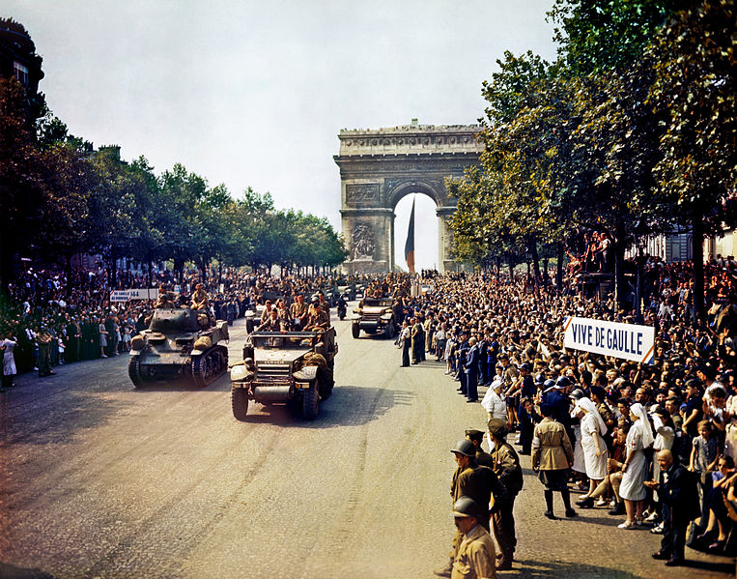
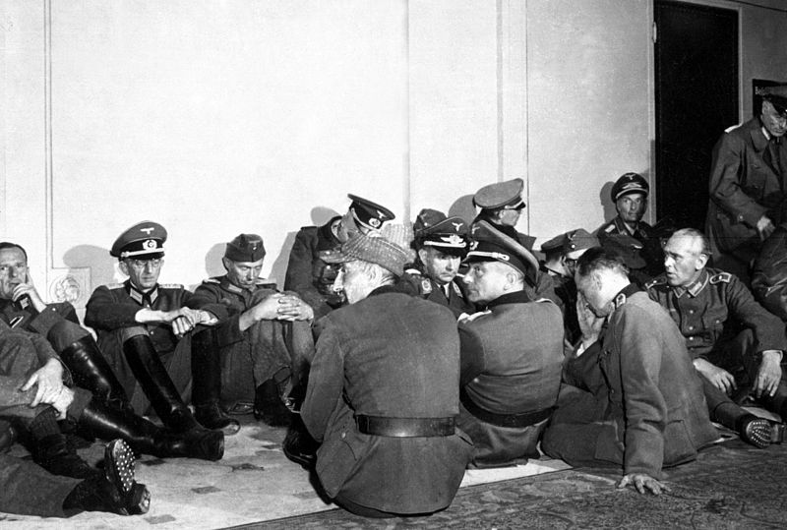
Liberation of Paris
Casualties
Free French & FFI
5,399 (9%)
Germany
16,000 (64%)
Victory
Defeat

